Slide 1
Willowridge HS Class of 2026 Senior Class Sponsors
Mr. Thristle Gibson – Senior Sponsor Admin
Mr. Rhyan Mays – Senior Sponsor
Ms. Iesha Harris – Senior Sponsor
Best way of contact: Email or call campus 281.634.2450

Slide 2
Senior Packages
Silver Package
Blue Package
Prom (April ‘26)
Senior Day Out (May)
Senior Picnic (Apr-May)
Senior Sunset (May)
Senior Brunch (May)
Friendsgiving (Nov ‘25)
2 Senior Shirts
1 Senior Hoodie
Yearbook
Senior Picnic (Apr-May)
Senior Sunset (May)
Senior Brunch (May)
Friendsgiving (Nov ‘25)
2 Senior Shirts
1 Senior Hoodie
Yearbook
$570.00
$455.00

Slide 3
A La Carte Menu
Prom $150
Senior Day Out $150
Senior Picnic $100
Senior Sunset $75
Senior Brunch $65
Friendsgiving $65
Senior Shirts $55
Senior Hoodie $55
Yearbook $85
A La Cart Total
$800

Slide 4
First Installment
First payment for packages are due November 1, 2025
If you do not make the first payment, this means you are purchasing everything a-la-cart.
Silver Package Installment:
$142.50
Blue Package Installment:
$113.75

Slide 5
Senior Memories
Senior class memory book ie. pictures, notes (book stays @ WHS)
Gift to Junior class ($ or tangible item, budget to be determined)
Senior Community Service (Spring)
Teacher Appreciation Activity (May 4-8 2026)
Senior activity t-shirts
Notes:
)

Slide 6
Fundraisers
Senior Sunrise
Homecoming Tailgate Booth
Movie night @ WHS
Hispanic Heritage Shirt
Pink Out Breast Cancer Shirt
And more

Slide 7
Sponsorships are available
Please contact immediately, 281.634.2450.
Electronic donations WHS Senior Class of 2026 Donation Page
“I have a sponsorship for the senior class, please inform Mr. Gibson, Mr. Mays and Ms. Harris that I have called.”

Slide 8

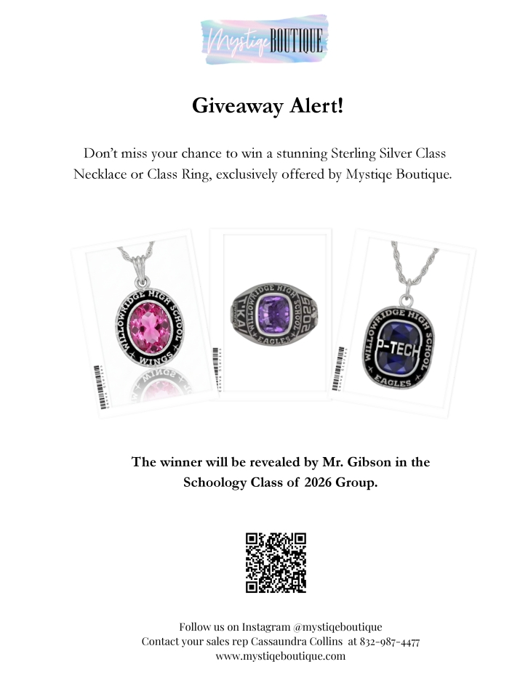

Slide 9
WHS 2026 Senior Class Page

